Slide 1
Regression Splines

Slide 2
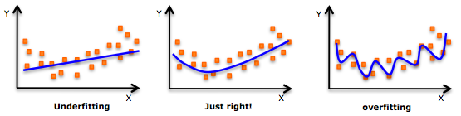
we noticed both it’s advantages and limitations of Linear Regression.
It assumed a linear relationship between the dependent and independent variables, which was rarely the case in reality.
As an improvement over this model, we have Polynomial Regression which generate better results (most of the time).
But using Polynomial Regression on datasets with high variability chances to result in over-fitting.
It is inherently non-local, i.e., changing the value of Y at one point in the training set can affect the fit of the polynomial for data points that are very far away.

Slide 3
Solution-Regression Splines
It uses a combination of linear/polynomial functions to fit the data.
instead of building one model for the entire dataset, divides the dataset into multiple bins and fits each bin with a separate model.
one of the most important non linear regression techniques.
A polynomial (like ax²+bx+c) is a smooth curve that spans the entire domain of the input variable. When you fit such a polynomial, the predicted curve is determined by all data points together, which imposed a global structure on the dataset not just a local neighborhood.
To overcome this, we can divide the distribution of the data into separate portions and fit linear or low degree polynomial functions on each of these portions.

Slide 4
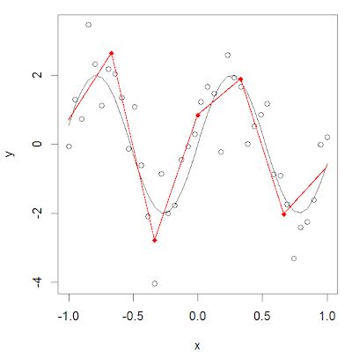
The points where the division occurs are called Knots.
Functions which we can use for modelling each piece/bin are known as Piecewise functions.

Slide 5
Piecewise Step Functions
One of the most common piecewise functions is a Step function.
Step function is a function which remains constant within the interval.
We can fit individual step functions to each of the divided portions in order to avoid imposing a global structure.
Here we break the range of X into bins, and fit a different constant in each bin.

Slide 6
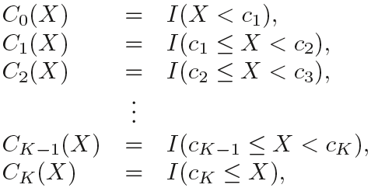
we create cut points C1 , C2, . . . , Ck in the range of X, and then construct K + 1 new variables.
where I( ) is an indicator function that returns a 1 if the condition is true and returns a 0 otherwise. For example, I(cK ≤ X ) equals 1 if cK ≤ X, otherwise it equals 0. For a given value of X, at most only one of C1, C2, . . ., CK can be non-zero, as X can only lie in any one of the bins.
Binned regression does not create continuous functions of the predictor, so in most cases we would expect no relationship between the input and output.

Slide 7

Piecewise Polynomials
Instead of fitting a constant function over different bins across the range of X, piecewise polynomial regression involves fitting separate low-degree polynomials over different regions of X.
As we use lower degrees of polynomials, we don’t observe high oscillations of the curve around the data.
For example, a piecewise quadratic polynomial works by fitting a quadratic regression equation:
where the coefficients β0 , β1 and β2 differ in different parts of the range of X.

Slide 8
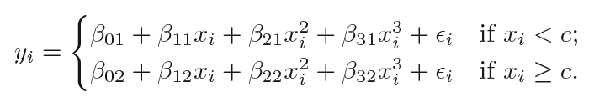
A piecewise cubic polynomial, with a single knot at a point c, takes the below form:
In other words, we fit two different polynomial functions to the data: one on the subset of the observations with xi < c, and one on the subset of the observations with xi ≥ c.
The first polynomial function has coefficients β₀₁, β₁₁, β₂₁, β₃₁ and the second has coefficients β₀₂, β₁₂, β₂₂, β₃₂.
Each of these polynomial functions can be fit using the least squares error metric.
This family of polynomial functions has 8 degrees of freedom, 4 for each polynomial (as there are 4 variables).

Slide 9
Using more knots leads to a more flexible piecewise polynomial, as we use different functions for every bin.
These functions depend only on the distribution of data of that particular bin.
In general, if we place K different knots throughout the range of X, we will end up fitting K+1 different cubic polynomials.
We can use any low degree polynomial to fit these individual bins.
For example, we can instead fit piecewise linear functions.
In fact, the stepwise functions used above are actually piecewise polynomials of degree 0.

Slide 10
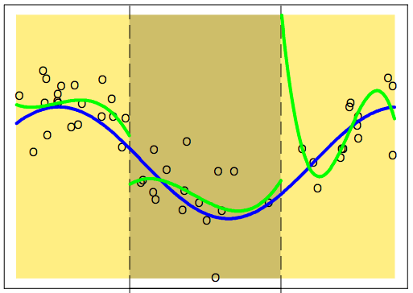
necessary conditions and constraints for forming piecewise polynomials
Constraints and Splines
  We might encounter certain situations where the polynomials at either end of a knot are not continuous at the knot.
  Such a condition should be avoided because the family of polynomials as a whole should generate a unique output for every input.

Slide 11
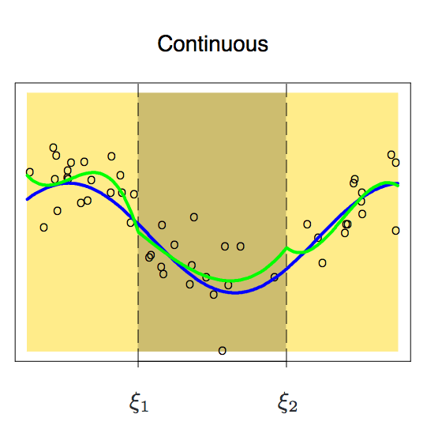
We can see from the above image that it outputs two different values at the first knot.
Thus, to avoid this, we should add an extra constraint/condition that the polynomials on either side of a knot should be continuous at the knot.
Now after adding that constraint, we get a continuous family of polynomials.
It looks like smoothness at the knots is still absent.

Slide 12
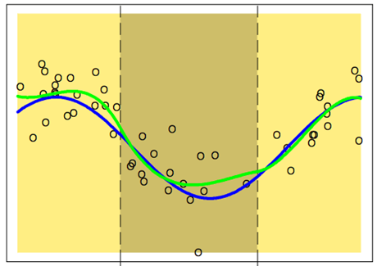

So to smoothen the polynomials at the knots, we add an extra constraint/condition: the first derivative of both the polynomials must be same.
One thing we should note: Each constraint that we impose on the piecewise cubic polynomials effectively frees up one degree of freedom, as we reduce the complexity of the resulting piecewise polynomial fit.
Therefore, in the above plot, we are using only 10 degrees of freedom instead of 12.
This plot uses 8 degrees of freedom instead of 12 as two constraints are imposed.

Slide 13
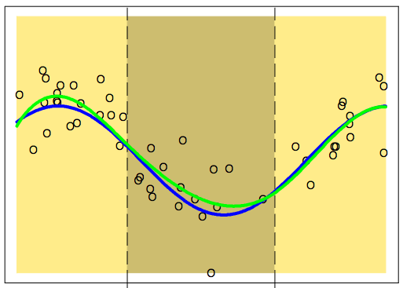
Although the above plot looks better, there is still some scope for improvement.
Now, we will impose an extra constraint: that the double derivatives of both the polynomials at a knot must be same.
This plot seems perfect for our study. It uses 6 degrees of freedom instead of 12.
Such a piecewise polynomial of degree m with m-1 continuous derivatives is called a Spline.
Hence, we have constructed a Cubic Spline in the above plot.
We can plot any degree of spline with m-1 continuous derivatives.

Slide 14
Cubic and Natural Cubic Splines
Cubic spline is a piecewise polynomial with a set of extra constraints (continuity, continuity of the first derivative, and continuity of the second derivative).
In general, a cubic spline with K knots uses cubic spline with a total of 4 + K degrees of freedom.
There is seldom any good reason to go beyond cubic-splines (unless one is interested in smooth derivatives).
We know that the behavior of polynomials that are fit to the data tends to be erratic near the boundaries.
Such variability can be dangerous.
These problems are resembled by splines, too.
The polynomials fit beyond the boundary knots behave even more wildly than the corresponding global polynomials in that region.
To smooth the polynomial beyond the boundary knots, we will use a special type of spline known as Natural Spline.
A natural cubic spline adds additional constraints, namely that the function is linear beyond the boundary knots. This constrains the cubic and quadratic parts there to 0, each reducing the degrees of freedom by 2. That’s 2 degrees of freedom at each of the two ends of the curve, reducing K+4 to K.

Slide 15
Choosing the Number and Locations of the Knots
When we fit a spline, where should we place the knots?
One potential place would be the area of high variability, because in those regions the polynomial coefficients can change rapidly. Hence, one option is to place more knots in places where we feel the function might vary most rapidly, and to place fewer knots where it seems more stable.
While this option can work well, in practice it is common to place knots in a uniform fashion. One way to do this is to specify the desired degrees of freedom, and then have the software automatically place the corresponding number of knots at uniform quantiles of the data.
Another option is to try out different numbers of knots and see which produces the best looking curve.

Slide 16
A more objective approach is to use cross-validation. With this method:
we remove a portion of the data,
fit a spline with a certain number of knots to the remaining data, and then,
use the spline to make predictions for the held-out portion.
We repeat this process multiple times until each observation has been left out once, and then compute the overall cross-validated RMSE.
This procedure can be repeated for different numbers of K knots.
Then the value of K giving the smallest RMSE is chosen.

